Slide 1

Instant Chat Application
BY
Jahnavi.k
Manohar.k
Anurag.m

Slide 2
Table of Contents
Project Overview
Introduction
Working of Chat Application
Functional Requirements

Slide 3
Project Overview
Instant Chat is a way communication with people around the world Before the
internet era we had letters through which we used to send our messages to the
people, but it used to take long time to reach and it is not secure but now
internet made our work easy by send our views to people by using internet and
this application provides security by using login credentials of the user so that
only the owner can access the information.

Slide 4
Introduction
Purpose:
The purpose of this project is to implement a socketProgramming-based chat application that will allow to create a multiple client to chat in private conversation.
Intended Audience:
This project is to create a chat application with the server andclients to enable the client to chat with many other clients. This project can play an important role in organization field where employees can be connected through internet.

Slide 5
Introduction
Project Scope :
The purpose of this project is to create a chat application which Enable the clients to chat with many other clients. Above all, we hope to provide a comfortable user experience along with ease of using the application.

Slide 6
Working Of Chat Application
The instant chat application is developed using C programming language. This application is used for communication between two or more users In the application we create registration for user using their credentials for Sign in and sign out purpose, and the information is stored in server storage location for security purpose when user try sign in and it shows login failed when user try sign with wrong password and he can send and receive messages with different users who have registered their names in the server and we can know the active users using active user list function and we can sign out when we are done using sign out function.

Slide 7
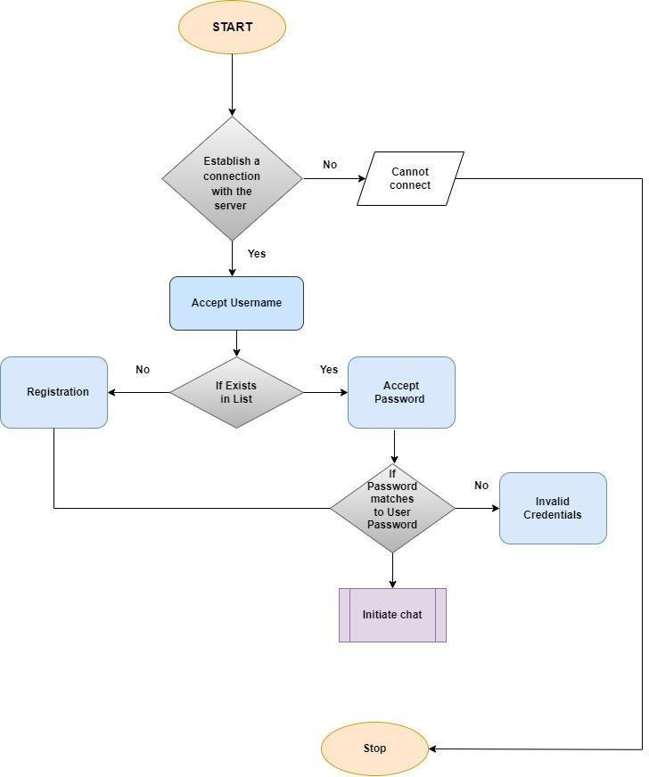
Flow Chart :

Slide 8
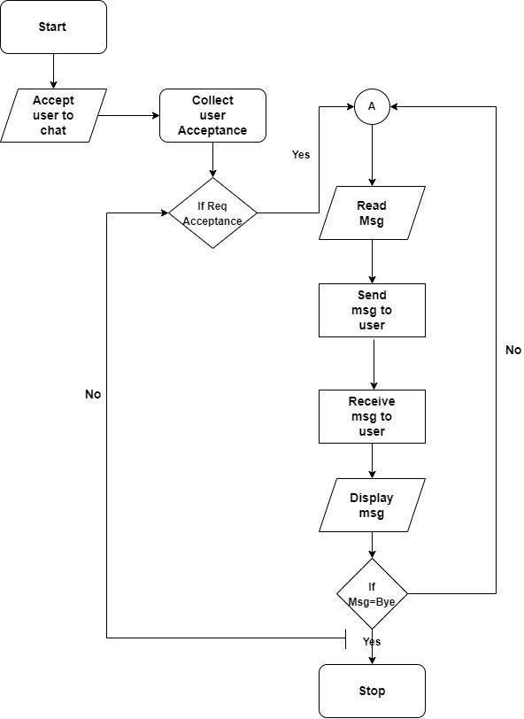
Flow Chart :

Slide 9
Functional Requirements
User Registration :
The user needs to register using his credentials for using the chat application.
User Validation :
This function verifies the user credentials when he tries to log in.
Active User List :
We can know the active users in the chat application.
Registered Users :
We can know who have registered the names.
Search Chat History :
User can view his chat history.

Slide 10
Functional Requirements
Failure Login :
Login failed when user try to sign in with wrong credentials.
Message Exchanges :
The information will move from one location to another in server.
Sending and Receiving messages :
The user will send and receive information using this function.
Sign-out :
When user wants to leave he will use sign-out function.

Slide 11
THANK YOU

